Slide 1
NodeJS
Memory & CPU
Optimization

Slide 2
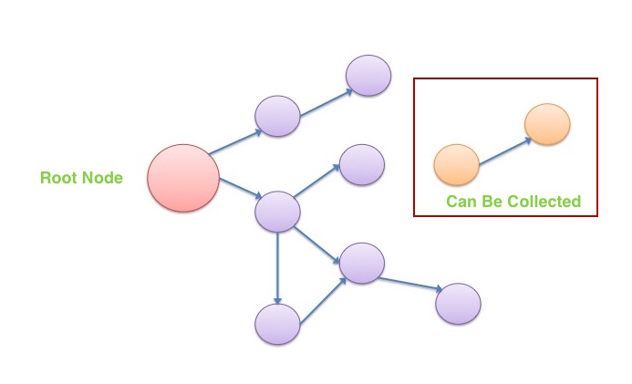
Memory Management
All memory is allocated and de-allocated by the V8 JavaScript engine.
V8 keeps a graph of all variables in the program, starting from the root node.
Nodes not reachable from root
node are released by V8.

Slide 3
When does a memory leak occur?
Memory leak occurs when some no-longer-needed-data is still reachable from the root node.
V8 will assume that the data is still being used and will not release the memory.
We need to locate the data that is being kept by mistake, and make sure V8 is able to clean it up.
Out of turn Garbage Collection could be a source of significant performance degradation.

Slide 4
Detect Memory Leak
Node allows us to manually trigger Garbage Collection
- using --expose-gc flag.
Check Heap Usage
- process.memoryUsage().heapUsed.
Collect the heapDump and inspect them in Chrome Developer Tools.

Slide 5
CPU Profiling
Use - -prof flag.
Run the code for sometime.
It will generate a file named isolate-*.
Run —prof-process on this file.

Slide 6
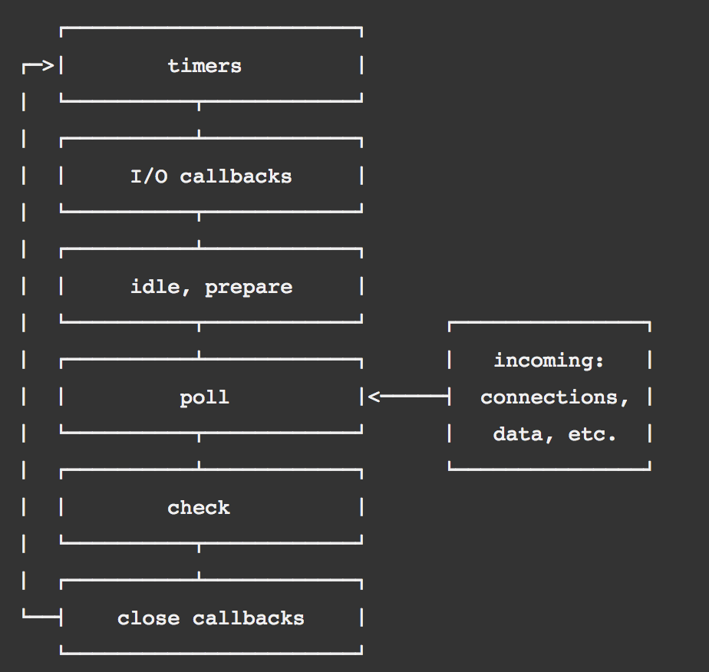
How Async Impacts Memory & CPU

Slide 7

Thank you!
Tushir Aggarwal
+91 9650821444
tushir.aggarwal@paytm.com

